Slide 1
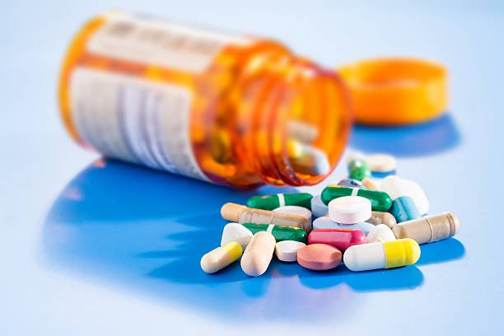

Medical Prescription Abuse Prevention
Team Technoholics

Slide 2
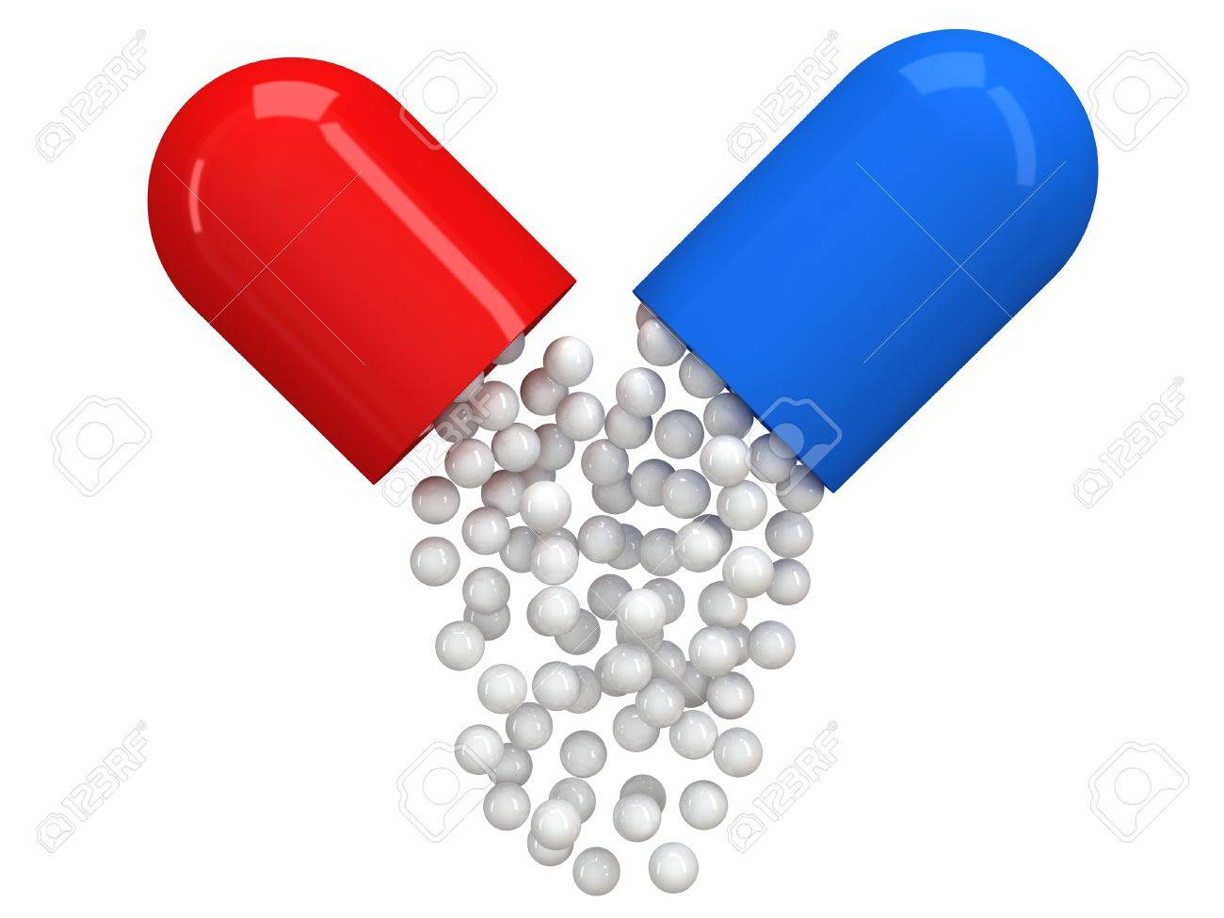
Why Medical Prescription Webapp?
Patients are using medical prescription to get medications beyond the intended dosage . Due to lack of awareness of patients and in hew of making more business, chemists have been selling duplicate medicines with salts not in compliance with medical prescription. This abuse prevails in various forms to make extra margin, shopkeeper sells costlier medicine varying with brand prescribed.This not only reduces the effectiveness of treatment and increase side effects but also leads to huge loses on insurance companies. How to detect or prevent this abuse?

Slide 3
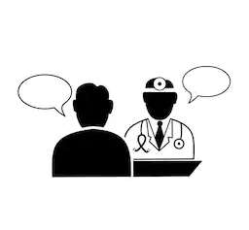

How it works?

Slide 4
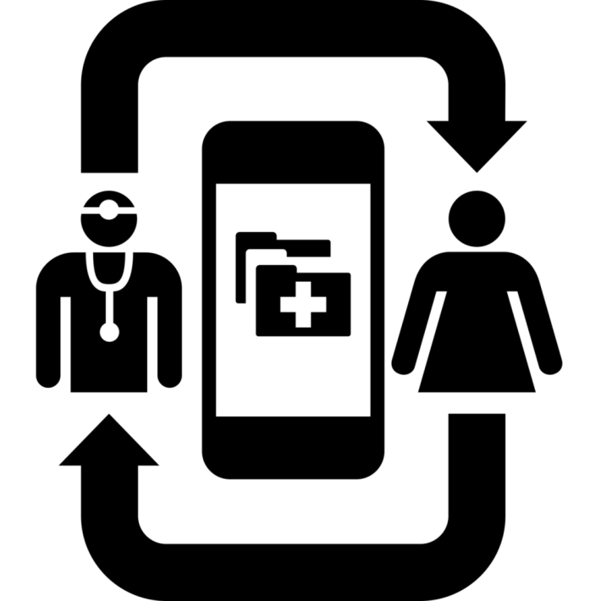
Doctor enters his credentials
Diagnoses patient, provides prescription
Chemist updates with medicine granted on given prescription
Doctor is updated with medicine granted/medicine not available.
If Insured, Amount deduces from patient’s account.
Patient receives history of all prescriptions

Slide 5
Future Scope

Slide 6
Technologies
JAVA 7/JAVA 8
Apache-tomcat-8
Angular JS 7
My SQL Workbench

Slide 7


